Slide 1
CSC 112: Computer Operating Systems Lecture 4 Fork (con’t), Introduction to I/O (Everything is a File!)
Department of Computer Science,
Hofstra University
Acknowledgement: Lecture slides based on UC Berkeley CS 162: Operating Systems and System Programming

Slide 2
Recall: Process Creating New Processes
pid_t fork() – copy the current process
New process has different pid
New process contains a single thread
Return value from fork(): pid (like an integer)
When > 0:
Running in (original) Parent process
return value is pid of new child
When = 0:
Running in new Child process
When < 0:
Error! Must handle somehow
Running in original process
State of original process duplicated in both Parent and Child!
Address Space (Memory), File Descriptors (covered later), etc…

Slide 3
Recall: fork1.c
#include <stdlib.h>
#include <stdio.h>
#include <unistd.h>
#include <sys/types.h>
int main(int argc, char *argv[]) {
pid_t cpid, mypid;
pid_t pid = getpid(); /* get current processes PID */
printf("Parent pid: %d\n", pid);
cpid = fork();
if (cpid > 0) { /* Parent Process */
mypid = getpid();
printf("[%d] parent of [%d]\n", mypid, cpid);
} else if (cpid == 0) { /* Child Process */
mypid = getpid();
printf("[%d] child\n", mypid);
} else {
perror("Fork failed");
}
}
c
p

Slide 4
Recall: fork1.c
#include <stdlib.h>
#include <stdio.h>
#include <unistd.h>
#include <sys/types.h>
int main(int argc, char *argv[]) {
pid_t cpid, mypid;
pid_t pid = getpid(); /* get current processes PID */
printf("Parent pid: %d\n", pid);
cpid = fork();
if (cpid > 0) { /* Parent Process */
mypid = getpid();
printf("[%d] parent of [%d]\n", mypid, cpid);
} else if (cpid == 0) { /* Child Process */
mypid = getpid();
printf("[%d] child\n", mypid);
} else {
perror("Fork failed");
}
}
p
c

Slide 5
Mystery: fork_race.c
int i;
pid_t cpid = fork();
if (cpid > 0) {
for (i = 0; i < 10; i++) {
printf("Parent: %d\n", i);
// sleep(1);
}
} else if (cpid == 0) {
for (i = 0; i > -10; i--) {
printf("Child: %d\n", i);
// sleep(1);
}
}
What does this print?
Would adding the calls to sleep() matter?
Recall: a process consists of one or more threads executing in an address space
Here, each process has a single thread
These threads execute concurrently

Slide 6
Process Management API
exit – terminate a process
fork – copy the current process
exec – change the program being run by the current process
wait – wait for a process to finish
kill – send a signal (interrupt-like notification) to another process
sigaction – set handlers for signals

Slide 7
Starting new Program: variants of exec
…
cpid = fork();
if (cpid > 0) { /* Parent Process */
tcpid = wait(&status);
} else if (cpid == 0) { /* Child Process */
char *args[] = {“ls”, “-l”, NULL};
execv(“/bin/ls”, args);
/* execv doesn’t return when it works.
So, if we got here, it failed! */
perror(“execv”);
exit(1);
}
…

Slide 8
fork2.c – parent waits for child to finish
int status;
pid_t tcpid;
…
cpid = fork();
if (cpid > 0) { /* Parent Process */
mypid = getpid();
printf("[%d] parent of [%d]\n", mypid, cpid);
tcpid = wait(&status);
printf("[%d] bye %d(%d)\n", mypid, tcpid, status);
} else if (cpid == 0) { /* Child Process */
mypid = getpid();
printf("[%d] child\n", mypid);
exit(42);
}
…

Slide 9
Process Management: The Shell pattern
child
pid=fork();
if (pid==0)
exec(…);
else
wait(&stat)
main() {
…
}
exec
fork
pid=fork();
if (pid==0)
exec(…);
else
wait(&stat)
parent
pid=fork();
if (pid==0)
exec(…);
else
wait(&stat)
fork
wait

Slide 10
Process Management API
exit – terminate a process
fork – copy the current process
exec – change the program being run by the current process
wait – wait for a process to finish
kill – send a signal (interrupt-like notification) to another process
sigaction – set handlers for signals

Slide 11
inf_loop.c
#include <stdlib.h>
#include <stdio.h>
#include <sys/types.h>
#include <unistd.h>
#include <signal.h>
void signal_callback_handler(int signum) {
printf(“Caught signal!\n”);
exit(1);
}
int main() {
struct sigaction sa;
sa.sa_flags = 0;
sigemptyset(&sa.sa_mask);
sa.sa_handler = signal_callback_handler;
sigaction(SIGINT, &sa, NULL);
while (1) {}
}
Q: What would happen if the process receives a SIGINT signal, but does not register a signal handler?
A: The process dies!
For each signal, there is a default handler defined by the system

Slide 12
Common POSIX Signals
SIGINT – control-C
SIGTERM – default for kill shell command
SIGSTP – control-Z (default action: stop process)
SIGKILL, SIGSTOP – terminate/stop process
Can’t be changed with sigaction
Why?

Slide 13
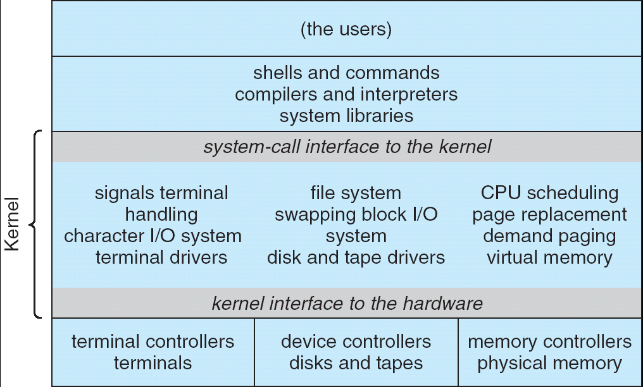
Recall: UNIX System Structure
Applications
User Mode
Standard Libs
Kernel Mode
Hardware

Slide 14
A Kind of Narrow Waist
Word Processing
Compilers
Web Browsers
Email
Databases
Web Servers
Application / Service
Portable OS Library
OS
User
System Call
Interface
System
Portable OS Kernel
Software
Platform support, Device Drivers
Hardware
x86
PowerPC
ARM
PCI
Ethernet (1Gbs/10Gbs)
802.11 a/g/n/ac
SCSI
Graphics
Thunderbolt

Slide 15
Recall: OS Library (libc) Issues Syscalls
Proc 1
Proc 2
Proc n
…
OS
Appln
login
Window Manager
…
libc
OS library
OS library
OS library
OS
OS Library: Code linked into the user-level application that provides a clean or more functional API to the user than just the raw syscalls
Most of this code runs at user level, but makes syscalls (which run at kernel level)

Slide 16
Unix/POSIX Idea: Everything is a “File”
Identical interface for:
Files on disk
Devices (terminals, printers, etc.)
Regular files on disk
Networking (sockets)
Local interprocess communication (pipes, sockets)
Based on the system calls open(), read(), write(), and close()
Additional: ioctl() for custom configuration that doesn’t quite fit
Note that the “Everything is a File” idea was a radical idea when proposed
Dennis Ritchie and Ken Thompson described this idea in their seminal paper on UNIX called “The UNIX Time-Sharing System” from 1974
I posted this on the resources page if you are curious

Slide 17
Aside: POSIX interfaces
POSIX: Portable Operating System Interface
Interface for application programmers (mostly)
Defines the term “Unix,” derived from AT&T Unix
Created to bring order to many Unix-derived OSes, so applications are portable
Partially available on non-Unix OSes, like Windows
Requires standard system call interface

Slide 18
The File System Abstraction
File
Named collection of data in a file system
POSIX File data: sequence of bytes
Could be text, binary, serialized objects, …
File Metadata: information about the file
Size, Modification Time, Owner, Security info, Access control
Directory
“Folder” containing files & directories
Hierarchical (graphical) naming
Path through the directory graph
Uniquely identifies a file or directory
Links and Volumes (later)

Slide 19
Connecting Processes, File Systems, and Users
Every process has a current working directory (CWD)
Can be set with system call: int chdir(const char *path); //change CWD
Absolute paths ignore CWD
/home/zgu/csc112
Relative paths are relative to CWD
index.html, ./index.html
Refers to index.html in current working directory
../index.html
Refers to index.html in parent of current working directory
~/index.html, ~csc112/index.html
Refers to index.html in the home directory

Slide 20

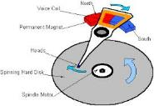




I/O and Storage Layers
Application / Service
High Level I/O
Streams (buffered I/O)
Low Level I/O
File Descriptors
Syscall
open(), read(), write(), close(), …
Open File Descriptions
File System
Files/Directories/Indexes
I/O Driver
Commands and Data Transfers
Disks, Flash, Controllers, DMA

Slide 21
C High-Level File API – Streams
Operates on “streams” – unformatted sequences of bytes (wither text or binary data), with a position:
Open stream represented by pointer to a FILE data structure
Error reported by returning a NULL pointer
#include <stdio.h>
FILE *fopen( const char *filename, const char *mode );
int fclose( FILE *fp );
Mode Text | Binary | Descriptions
r | rb | Open existing file for reading
w | wb | Open for writing; created if does not exist
a | ab | Open for appending; created if does not exist
r+ | rb+ | Open existing file for reading & writing.
w+ | wb+ | Open for reading & writing; truncated to zero if exists, create otherwise
a+ | ab+ | Open for reading & writing. Created if does not exist. Read from beginning, write as append

Slide 22
C API Standard Streams – stdio.h
Three predefined streams are opened implicitly when the program is executed.
FILE *stdin – normal source of input, can be redirected
FILE *stdout – normal source of output, can too
FILE *stderr – diagnostics and errors
STDIN / STDOUT enable composition in Unix
All can be redirected
cat hello.txt | grep “World!”
cat’s stdout goes to grep’s stdin

Slide 23
C High-Level File API
// character oriented
int fputc( int c, FILE *fp ); // rtn c or EOF on err
int fputs( const char *s, FILE *fp ); // rtn > 0 or EOF
int fgetc( FILE * fp );
char *fgets( char *buf, int n, FILE *fp );
// block oriented
size_t fread(void *ptr, size_t size_of_elements,
size_t number_of_elements, FILE *a_file);
size_t fwrite(const void *ptr, size_t size_of_elements,
size_t number_of_elements, FILE *a_file);
// formatted
int fprintf(FILE *restrict stream, const char *restrict format, ...);
int fscanf(FILE *restrict stream, const char *restrict format, ... );

Slide 24
C Streams: Char-by-Char I/O
int main(void) {
FILE* input = fopen(“input.txt”, “r”);
FILE* output = fopen(“output.txt”, “w”);
int c;
c = fgetc(input);
while (c != EOF) {
fputc(output, c);
c = fgetc(input);
}
fclose(input);
fclose(output);
}

Slide 25
C High-Level File API
// character oriented
int fputc( int c, FILE *fp ); // rtn c or EOF on err
int fputs( const char *s, FILE *fp ); // rtn > 0 or EOF
int fgetc( FILE * fp );
char *fgets( char *buf, int n, FILE *fp );
// block oriented
size_t fread(void *ptr, size_t size_of_elements,
size_t number_of_elements, FILE *a_file);
size_t fwrite(const void *ptr, size_t size_of_elements,
size_t number_of_elements, FILE *a_file);
// formatted
int fprintf(FILE *restrict stream, const char *restrict format, ...);
int fscanf(FILE *restrict stream, const char *restrict format, ... );

Slide 26
C Streams: Block-by-Block I/O
#define BUFFER_SIZE 1024
int main(void) {
FILE* input = fopen("input.txt", "r");
FILE* output = fopen("output.txt", "w");
char buffer[BUFFER_SIZE];
size_t length;
length = fread(buffer, BUFFER_SIZE, sizeof(char), input);
while (length > 0) {
fwrite(buffer, length, sizeof(char), output);
length = fread(buffer, BUFFER_SIZE, sizeof(char), input);
}
fclose(input);
fclose(output);
}

Slide 27
Aside: Check your Errors!
Systems programmers should always be paranoid!
Otherwise you get intermittently buggy code
We should really be writing things like:
FILE* input = fopen(“input.txt”, “r”);
if (input == NULL) {
// Prints our string and error msg.
perror(“Failed to open input file”)
}
Be thorough about checking return values!
Want failures to be systematically caught and dealt with
I may be a bit loose with error checking for examples in class (to keep short)
Do as I say, not as I show in class!

Slide 28
C High-Level File API: Positioning The Pointer
int fseek(FILE *stream, long int offset, int whence);
long int ftell (FILE *stream)
void rewind (FILE *stream)
For fseek(), the offset is interpreted based on the whence argument (constants in stdio.h):
SEEK_SET: Then offset interpreted from beginning (position 0)
SEEK_END: Then offset interpreted backwards from end of file
SEEK_CUR: Then offset interpreted from current position
Overall preserves high-level abstraction of a uniform stream of objects
offset (SEEK_SET)
offset (SEEK_END)
whence
offset (SEEK_CUR)

Slide 29
I/O and Storage Layers
Application / Service
High Level I/O
Streams (buffered I/O)
Low Level I/O
File Descriptors
Syscall
open(), read(), write(), close(), …
Open File Descriptions
File System
Files/Directories/Indexes
I/O Driver
Commands and Data Transfers
Disks, Flash, Controllers, DMA

Slide 30
Low-Level File I/O: The RAW system-call interface
#include <fcntl.h>
#include <unistd.h>
#include <sys/types.h>
int open (const char *filename, int flags [, mode_t mode])
int creat (const char *filename, mode_t mode)
int close (int filedes)
Bit vector of:
Access modes (Rd, Wr, …)
Open Flags (Create, …)
Operating modes (Appends, …)
Bit vector of Permission Bits:
User|Group|Other X R|W|X
Integer return from open() is a file descriptor
Error indicated by return < 0: the global errno variable set with error (see man pages)
Operations on file descriptors:
Open system call created an open file description entry in system-wide table of open files
Open file description object in the kernel represents an instance of an open file
Why give user an integer instead of a pointer to the file description in kernel?

Slide 31
C Low-Level (pre-opened) Standard Descriptors
#include <unistd.h>
STDIN_FILENO - macro has value 0
STDOUT_FILENO - macro has value 1
STDERR_FILENO - macro has value 2
// Get file descriptor inside FILE *
int fileno (FILE *stream)
// Make FILE * from descriptor
FILE * fdopen (int filedes, const char *opentype)

Slide 32
Low-Level File API
Read data from open file using file descriptor: ssize_t read (int filedes, void *buffer, size_t maxsize)
Reads up to maxsize bytes – might actually read less!
returns bytes read, 0 => EOF, -1 => error
Write data to open file using file descriptor ssize_t write (int filedes, const void *buffer, size_t size)
returns number of bytes written
Reposition file offset within kernel (this is independent of any position held by high-level FILE descriptor for this file! off_t lseek (int filedes, off_t offset, int whence)

Slide 33
Example: lowio.c
int main() {
char buf[1000];
int fd = open("lowio.c", O_RDONLY, S_IRUSR | S_IWUSR);
ssize_t rd = read(fd, buf, sizeof(buf));
int err = close(fd);
ssize_t wr = write(STDOUT_FILENO, buf, rd);
}
How many bytes does this program read?

Slide 34
POSIX I/O: Design Patterns
Open before use
Access control check, setup happens here
Byte-oriented
Least common denominator
OS responsible for hiding the fact that real devices may not work this way (e.g. hard drive stores data in blocks)
Explicit close

Slide 35
POSIX I/O: Kernel Buffering
Reads are buffered inside kernel
Part of making everything byte-oriented
Process is blocked while waiting for device
Let other processes run while gathering result
Writes are buffered inside kernel
Complete in background (more later on)
Return to user when data is “handed off” to kernel
This buffering is part of global buffer management and caching for block devices (such as disks)
Items typically cached in quanta of disk block sizes
We will have many interesting things to say about this buffering when we dive into the kernel

Slide 36
Low-Level I/O: Other Operations
Operations specific to terminals, devices, networking, …
e.g., ioctl
Duplicating descriptors
int dup2(int old, int new);
int dup(int old);
Pipes – channel
int pipe(int pipefd[2]);
Writes to pipefd[1] can be read from pipefd[0]
File Locking
Memory-Mapping Files
Asynchronous I/O

Slide 37
High-Level vs. Low-Level File API
High-Level Operation:
Low-Level Operation:
size_t fread(…) {
Do some work like a normal fn…
asm code … syscall # into %eax
put args into registers %ebx, …
special trap instruction
ssize_t read(…) {
asm code … syscall # into %eax
put args into registers %ebx, …
special trap instruction
Kernel:
Kernel:
get args from regs
dispatch to system func
Do the work to read from the file
Store return value in %eax
get args from regs
dispatch to system func
Do the work to read from the file
Store return value in %eax
get return values from regs
Do some more work like a normal fn…
};
get return values from regs
};

Slide 38
High-Level vs. Low-Level File API
Streams are buffered in user memory: printf("Beginning of line ");
sleep(10); // sleep for 10 seconds
printf("and end of line\n");
Prints out everything at once
Operations on file descriptors are visible immediately
write(STDOUT_FILENO, "Beginning of line ", 18);
sleep(10);
write("and end of line \n", 16);
Outputs "Beginning of line" 10 seconds earlier than “and end of line”

Slide 39
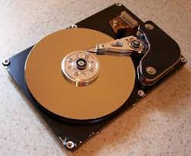
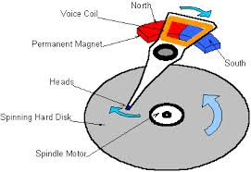
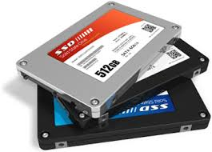

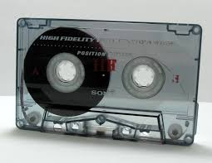
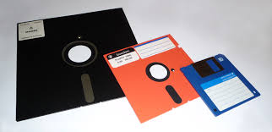
What’s below the surface ??
Application / Service
High Level I/O
streams
Low Level I/O
handles
Syscall
registers
File System
descriptors
I/O Driver
Commands and Data Transfers
Disks, Flash, Controllers, DMA

Slide 40
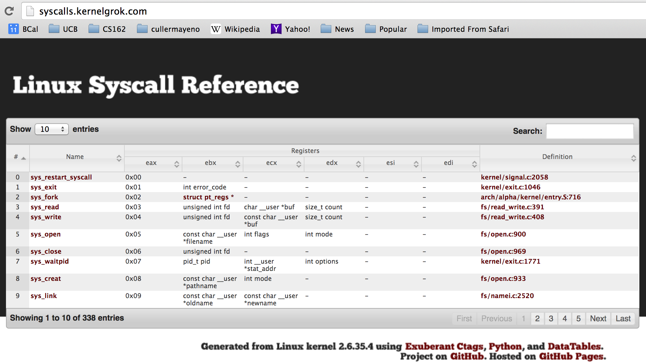
Recall: SYSCALL
Low level lib parameters are set up in registers and syscall instruction is issued
A type of synchronous exception that enters well-defined entry points into kernel

Slide 41
What’s below the surface ??
File descriptor number
- an int
Application / Service
High Level I/O
streams
Low Level I/O
handles
Syscall
registers
File System
descriptors
File Descriptors
a struct with all the info about the files
I/O Driver
Commands and Data Transfers
Disks, Flash, Controllers, DMA

Slide 42
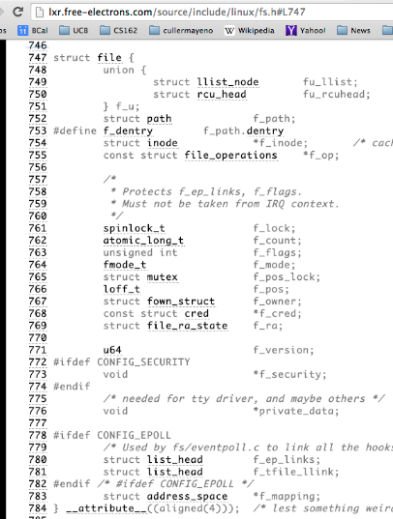
What’s in an Open File Description?
Inside Kernel!
For our purposes, the two most important things are:
Where to find the file data on disk
The current position within the file

Slide 43
File System: from syscall to driver
In fs/read_write.c
ssize_t vfs_read(struct file *file, char __user *buf, size_t count, loff_t *pos)
{
ssize_t ret;
if (!(file->f_mode & FMODE_READ)) return -EBADF;
if (!file->f_op || (!file->f_op->read && !file->f_op->aio_read))
return -EINVAL;
if (unlikely(!access_ok(VERIFY_WRITE, buf, count))) return -EFAULT;
ret = rw_verify_area(READ, file, pos, count);
if (ret >= 0) {
count = ret;
if (file->f_op->read)
ret = file->f_op->read(file, buf, count, pos);
else
ret = do_sync_read(file, buf, count, pos);
if (ret > 0) {
fsnotify_access(file->f_path.dentry);
add_rchar(current, ret);
}
inc_syscr(current);
}
return ret;
}
Read up to “count” bytes from “file” starting from “pos” into “buf”.
Return error or number of bytes read.

Slide 44
File System: from syscall to driver
In fs/read_write.c
ssize_t vfs_read(struct file *file, char __user *buf, size_t count, loff_t *pos)
{
ssize_t ret;
if (!(file->f_mode & FMODE_READ)) return -EBADF;
if (!file->f_op || (!file->f_op->read && !file->f_op->aio_read))
return -EINVAL;
if (unlikely(!access_ok(VERIFY_WRITE, buf, count))) return -EFAULT;
ret = rw_verify_area(READ, file, pos, count);
if (ret >= 0) {
count = ret;
if (file->f_op->read)
ret = file->f_op->read(file, buf, count, pos);
else
ret = do_sync_read(file, buf, count, pos);
if (ret > 0) {
fsnotify_access(file->f_path.dentry);
add_rchar(current, ret);
}
inc_syscr(current);
}
return ret;
}
Make sure we are allowed to read this file

Slide 45
File System: from syscall to driver
In fs/read_write.c
ssize_t vfs_read(struct file *file, char __user *buf, size_t count, loff_t *pos)
{
ssize_t ret;
if (!(file->f_mode & FMODE_READ)) return -EBADF;
if (!file->f_op || (!file->f_op->read && !file->f_op->aio_read))
return -EINVAL;
if (unlikely(!access_ok(VERIFY_WRITE, buf, count))) return -EFAULT;
ret = rw_verify_area(READ, file, pos, count);
if (ret >= 0) {
count = ret;
if (file->f_op->read)
ret = file->f_op->read(file, buf, count, pos);
else
ret = do_sync_read(file, buf, count, pos);
if (ret > 0) {
fsnotify_access(file->f_path.dentry);
add_rchar(current, ret);
}
inc_syscr(current);
}
return ret;
}
Check if file has read methods

Slide 46
File System: from syscall to driver
In fs/read_write.c
ssize_t vfs_read(struct file *file, char __user *buf, size_t count, loff_t *pos)
{
ssize_t ret;
if (!(file->f_mode & FMODE_READ)) return -EBADF;
if (!file->f_op || (!file->f_op->read && !file->f_op->aio_read))
return -EINVAL;
if (unlikely(!access_ok(VERIFY_WRITE, buf, count))) return -EFAULT;
ret = rw_verify_area(READ, file, pos, count);
if (ret >= 0) {
count = ret;
if (file->f_op->read)
ret = file->f_op->read(file, buf, count, pos);
else
ret = do_sync_read(file, buf, count, pos);
if (ret > 0) {
fsnotify_access(file->f_path.dentry);
add_rchar(current, ret);
}
inc_syscr(current);
}
return ret;
}
Check whether we can write to buf (e.g., buf is in the user space range)
unlikely(): hint to branch prediction this condition is unlikely

Slide 47
File System: from syscall to driver
In fs/read_write.c
ssize_t vfs_read(struct file *file, char __user *buf, size_t count, loff_t *pos)
{
ssize_t ret;
if (!(file->f_mode & FMODE_READ)) return -EBADF;
if (!file->f_op || (!file->f_op->read && !file->f_op->aio_read))
return -EINVAL;
if (unlikely(!access_ok(VERIFY_WRITE, buf, count))) return -EFAULT;
ret = rw_verify_area(READ, file, pos, count);
if (ret >= 0) {
count = ret;
if (file->f_op->read)
ret = file->f_op->read(file, buf, count, pos);
else
ret = do_sync_read(file, buf, count, pos);
if (ret > 0) {
fsnotify_access(file->f_path.dentry);
add_rchar(current, ret);
}
inc_syscr(current);
}
return ret;
}
Check whether we read from a valid range in the file.

Slide 48
File System: from syscall to driver
In fs/read_write.c
ssize_t vfs_read(struct file *file, char __user *buf, size_t count, loff_t *pos)
{
ssize_t ret;
if (!(file->f_mode & FMODE_READ)) return -EBADF;
if (!file->f_op || (!file->f_op->read && !file->f_op->aio_read))
return -EINVAL;
if (unlikely(!access_ok(VERIFY_WRITE, buf, count))) return -EFAULT;
ret = rw_verify_area(READ, file, pos, count);
if (ret >= 0) {
count = ret;
if (file->f_op->read)
ret = file->f_op->read(file, buf, count, pos);
else
ret = do_sync_read(file, buf, count, pos);
if (ret > 0) {
fsnotify_access(file->f_path.dentry);
add_rchar(current, ret);
}
inc_syscr(current);
}
return ret;
}
If driver provide a read function (f_op->read) use it; otherwise use do_sync_read()

Slide 49
File System: from syscall to driver
In fs/read_write.c
ssize_t vfs_read(struct file *file, char __user *buf, size_t count, loff_t *pos)
{
ssize_t ret;
if (!(file->f_mode & FMODE_READ)) return -EBADF;
if (!file->f_op || (!file->f_op->read && !file->f_op->aio_read))
return -EINVAL;
if (unlikely(!access_ok(VERIFY_WRITE, buf, count))) return -EFAULT;
ret = rw_verify_area(READ, file, pos, count);
if (ret >= 0) {
count = ret;
if (file->f_op->read)
ret = file->f_op->read(file, buf, count, pos);
else
ret = do_sync_read(file, buf, count, pos);
if (ret > 0) {
fsnotify_access(file->f_path.dentry);
add_rchar(current, ret);
}
inc_syscr(current);
}
return ret;
}
Notify the parent of this file that the file was read (see http://www.fieldses.org/~bfields/kernel/vfs.txt)

Slide 50
File System: from syscall to driver
In fs/read_write.c
ssize_t vfs_read(struct file *file, char __user *buf, size_t count, loff_t *pos)
{
ssize_t ret;
if (!(file->f_mode & FMODE_READ)) return -EBADF;
if (!file->f_op || (!file->f_op->read && !file->f_op->aio_read))
return -EINVAL;
if (unlikely(!access_ok(VERIFY_WRITE, buf, count))) return -EFAULT;
ret = rw_verify_area(READ, file, pos, count);
if (ret >= 0) {
count = ret;
if (file->f_op->read)
ret = file->f_op->read(file, buf, count, pos);
else
ret = do_sync_read(file, buf, count, pos);
if (ret > 0) {
fsnotify_access(file->f_path.dentry);
add_rchar(current, ret);
}
inc_syscr(current);
}
return ret;
}
Update the number of bytes read by “current” task (for scheduling purposes)

Slide 51
File System: from syscall to driver
In fs/read_write.c
ssize_t vfs_read(struct file *file, char __user *buf, size_t count, loff_t *pos)
{
ssize_t ret;
if (!(file->f_mode & FMODE_READ)) return -EBADF;
if (!file->f_op || (!file->f_op->read && !file->f_op->aio_read))
return -EINVAL;
if (unlikely(!access_ok(VERIFY_WRITE, buf, count))) return -EFAULT;
ret = rw_verify_area(READ, file, pos, count);
if (ret >= 0) {
count = ret;
if (file->f_op->read)
ret = file->f_op->read(file, buf, count, pos);
else
ret = do_sync_read(file, buf, count, pos);
if (ret > 0) {
fsnotify_access(file->f_path.dentry);
add_rchar(current, ret);
}
inc_syscr(current);
}
return ret;
}
Update the number of read syscalls by “current” task (for scheduling purposes)

Slide 52
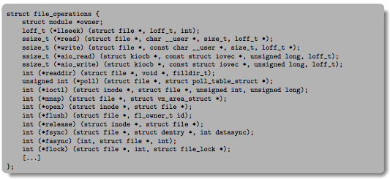
Lower Level Driver
Associated with particular hardware device
Registers / Unregisters itself with the kernel
Handler functions for each of the file operations

Slide 53
Device Drivers
Device Driver: Device-specific code in the kernel that interacts directly with the device hardware
Supports a standard, internal interface
Same kernel I/O system can interact easily with different device drivers
Special device-specific configuration supported with the ioctl() system call
Device Drivers typically divided into two pieces:
Top half: accessed in call path from system calls
implements a set of standard, cross-device calls like open(), close(), read(), write(), ioctl(), strategy()
This is the kernel’s interface to the device driver
Top half will start I/O to device, may put thread to sleep until finished
Bottom half: run as interrupt routine
Gets input or transfers next block of output
May wake sleeping threads if I/O now complete

Slide 54
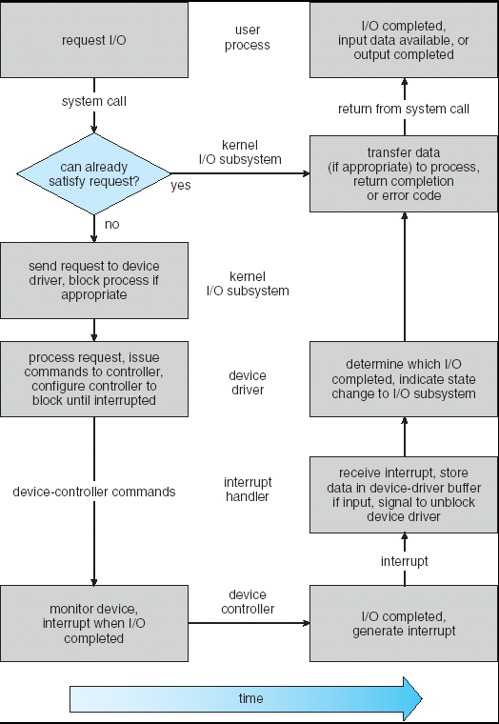
Life Cycle of An I/O Request
User
Program
Kernel I/O
Subsystem
Device Driver
Top Half
Device Driver
Bottom Half
Device
Hardware

Slide 55
Communication between processes
Can we view files as communication channels?
Producer and Consumer of a file may be distinct processes
May be separated in time (or not)
However, what if data written once and consumed once?
Don’t we want something more like a queue?
Can still look like File I/O!
write(wfd, wbuf, wlen);
n = read(rfd,rbuf,rmax);

Slide 56
Communication Across the world looks like file IO!
write(wfd, wbuf, wlen);
n = read(rfd,rbuf,rmax);
Connected queues over the Internet
But what’s the analog of open?
What is the namespace?
How are they connected in time?

Slide 57
Request Response Protocol
Client (issues requests)
Server (performs operations)
write(rqfd, rqbuf, buflen);
requests
n = read(rfd,rbuf,rmax);
wait
service request
write(wfd, respbuf, len);
responses
n = read(resfd,resbuf,resmax);

Slide 58
Request Response Protocol: Across Network
Client (issues requests)
Server (performs operations)
write(rqfd, rqbuf, buflen);
requests
n = read(rfd,rbuf,rmax);
wait
service request
write(wfd, respbuf, len);
responses
n = read(resfd,resbuf,resmax);

Slide 59
The Socket Abstraction: Endpoint for Communication
Key Idea: Communication across the world looks like File I/O
Sockets: Endpoint for Communication
Queues to temporarily hold results
Connection: Two Sockets Connected Over the network ⇒ IPC over network!
How to open()?
What is the namespace?
How are they connected in time?
write(wfd, wbuf, wlen);
Process
Socket
Socket
Process
n = read(rfd, rbuf, rmax);

Slide 60
Sockets: More Details
Socket: An abstraction for one endpoint of a network connection
Another mechanism for inter-process communication
Most operating systems (Linux, Mac OS X, Windows) provide this, even if they don’t copy rest of UNIX I/O
Standardized by POSIX
First introduced in 4.2 BSD (Berkeley Standard Distribution) Unix
This release had some huge benefits (and excitement from potential users)
Runners waiting at release time to get release on tape and take to businesses
Same abstraction for any kind of network
Local (within same machine)
The Internet (TCP/IP, UDP/IP)
Things “no one” uses anymore (OSI, Appletalk, IPX, …)

Slide 61
Sockets: More Details
Looks just like a file with a file descriptor
Corresponds to a network connection (two queues)
write adds to output queue (queue of data destined for other side)
read removes from it input queue (queue of data destined for this side)
Some operations do not work, e.g. lseek
How can we use sockets to support real applications?
A bidirectional byte stream isn’t useful on its own…
May need messaging facility to partition stream into chunks
May need RPC facility to translate one environment to another and provide the abstraction of a function call over the network

Slide 62


Simple Example: Echo Server
“hello, world”
“hello, world”
Client
Web Server

Slide 63


Simple Example: Echo Server
Client (issues requests)
Server (services requests)
fgets(sndbuf,bufsize,stdin);
write(sockfd,sndbuf,strlen(sndbuf)+1);
n = read(sockfd,reqbuf,…);
wait
n = read(sockfd,rcvbuf, …);
Server
Socket
print
Client
Socket
wait
write(sockfd,reqbuf,…);
print

Slide 64
Echo client-server example
void client(int sockfd) {
int n;
char sndbuf[MAXIN]; char rcvbuf[MAXOUT];
while (1) {
fgets(sndbuf,MAXIN,stdin); /* prompt */
write(sockfd, sndbuf, strlen(sndbuf)+1); /* send (including null terminator) */
memset(rcvbuf,0,MAXOUT); /* clear */
n=read(sockfd, rcvbuf, MAXOUT); /* receive */
write(STDOUT_FILENO, rcvbuf, n); /* echo */
}
void server(int consockfd) {
char reqbuf[MAXREQ];
int n;
while (1) {
memset(reqbuf,0, MAXREQ);
len = read(consockfd,reqbuf,MAXREQ); /* Recv */
if (n <= 0) return;
write(STDOUT_FILENO, reqbuf, n);
write(consockfd, reqbuf, n); /* echo*/
}
}

Slide 65
What Assumptions are we Making?
Reliable
Write to a file => Read it back. Nothing is lost.
Write to a (TCP) socket => Read from the other side, same.
In order (sequential stream)
Write X then write Y => read gets X then read gets Y
When ready?
File read gets whatever is there at the time
Actually need to loop and read until we receive the terminator (‘\0’)
Assumes writing already took place
Blocks if nothing has arrived yet

Slide 66
Socket Creation
File systems provide a collection of permanent objects in a structured name space:
Processes open, read/write/close them
Files exist independently of processes
Easy to name what file to open()
Pipes: one-way communication between processes on same (physical) machine
Single queue
Created transiently by a call to pipe()
Passed from parent to children (descriptors inherited from parent process)
Sockets: two-way communication between processes on same or different machine
Two queues (one in each direction)
Processes can be on separate machines: no common ancestor
How do we name the objects we are opening?
How do these completely independent programs know that the other wants to “talk” to them?

Slide 67
Namespaces for Communication over IP
Hostname
www.hofstra.edu
IP address
128.32.244.172 (IPv4, 32-bit Integer)
2607:f140:0:81::f (IPv6, 128-bit Integer)
Port Number
0-1023 are “well known” or “system” ports
Superuser privileges to bind to one
1024 – 49151 are “registered” ports (registry)
Assigned by IANA for specific services
49152–65535 (2¹⁵+2¹⁴ to 2¹⁶−1) are “dynamic” or “private”
Automatically allocated as “ephemeral ports”

Slide 68
Connection Setup over TCP/IP
Client Side
Server Side
Server
Socket
Server Listening:
Server IP addr
well-known port,
Protocol (TCP/IP)
Connection request:
Client IP addr
Client Port
Protocol (TCP/IP)
Request Connection
new
socket
socket
socket
connection
Special kind of socket: server socket
Has file descriptor
Can’t read or write
Two operations:
listen(): Start allowing clients to connect
accept(): Create a new socket for a particular client

Slide 69
Connection Setup over TCP/IP
Client Side
Server Side
Server
Socket
Server Listening:
Server IP addr
well-known port,
Protocol (TCP/IP)
Connection request:
Client IP addr
Client Port
Protocol (TCP/IP)
Request Connection
new
socket
socket
socket
connection
5-Tuple identifies each connection:
Source IP Address
Destination IP Address
Source Port Number
Destination Port Number
Protocol (always TCP here)
Often, Client Port “randomly” assigned
Done by OS during client socket setup
Server Port often “well known”
80 (web), 443 (secure web), 25 (sendmail), etc
Well-known ports from 0—1023

Slide 70
Web Server
Request
Reply
Client
Web Server

Slide 71
Client-Server Models
Client 1
Client 2
Server
***
Client n
File servers, web, FTP, Databases, …
Many clients accessing a common server

Slide 72
Sockets in concept
Client
Server
Create Server Socket
Create Client Socket
Bind it to an Address
(host:port)
Connect it to server (host:port)
Listen for Connection
Accept syscall()
Connection Socket
Connection Socket
write request
read request
read response
write response
Close Client Socket
Close Connection Socket
Close Server Socket

Slide 73
Client Protocol
char *host_name, *port_name;
// Create a socket
struct addrinfo *server = lookup_host(host_name, port_name);
int sock_fd = socket(server->ai_family, server->ai_socktype,
server->ai_protocol);
// Connect to specified host and port
connect(sock_fd, server->ai_addr, server->ai_addrlen);
// Carry out Client-Server protocol
run_client(sock_fd);
/* Clean up on termination */
close(sock_fd);

Slide 74
Server Protocol (v1)
// Create socket to listen for client connections
char *port_name;
struct addrinfo *server = setup_address(port_name);
int server_socket = socket(server->ai_family, server->ai_socktype, server->ai_protocol);
// Bind socket to specific port
bind(server_socket, server->ai_addr, server->ai_addrlen);
// Start listening for new client connections
listen(server_socket, MAX_QUEUE);
while (1) {
// Accept a new client connection, obtaining a new socket
int conn_socket = accept(server_socket, NULL, NULL);
serve_client(conn_socket);
close(conn_socket);
}
close(server_socket);

Slide 75
How Could the Server Protect Itself?
Handle each connection in a separate process
This will mean that the logic serving each request will be “sandboxed” away from the main server process

Slide 76
Sockets With Protection (each connection has own process)
Client
Server
Create Server Socket
Create Client Socket
Bind it to an Address
(host:port)
Connect it to server (host:port)
Listen for Connection
Accept syscall()
Connection Socket
Connection Socket
Child
Parent
Close Listen Socket
Close Connection Socket
write request
read request
read response
write response
Wait for child
Close Client Socket
Close Connection Socket
Close Server Socket

Slide 77
Server Protocol (v2)
// Socket setup code elided…
while (1) {
// Accept a new client connection, obtaining a new socket
int conn_socket = accept(server_socket, NULL, NULL);
pid_t pid = fork();
if (pid == 0) {
close(server_socket);
serve_client(conn_socket);
close(conn_socket);
exit(0);
} else {
close(conn_socket);
wait(NULL);
}
}
close(server_socket);

Slide 78
Concurrent Server
So far, in the server:
Listen will queue requests
Buffering present elsewhere
But server waits for each connection to terminate before servicing the next
A concurrent server can handle and service a new connection before the previous client disconnects

Slide 79
Sockets With Protection and Concurrency
Client
Server
Create Server Socket
Create Client Socket
Bind it to an Address
(host:port)
Connect it to server (host:port)
Listen for Connection
Accept syscall()
Connection Socket
Connection Socket
Child
Parent
Close Listen Socket
Close Connection Socket
write request
read request
read response
write response
Close Client Socket
Close Connection Socket
Close Server Socket

Slide 80
Server Protocol (v3)
// Socket setup code elided…
while (1) {
// Accept a new client connection, obtaining a new socket
int conn_socket = accept(server_socket, NULL, NULL);
pid_t pid = fork();
if (pid == 0) {
close(server_socket);
serve_client(conn_socket);
close(conn_socket);
exit(0);
} else {
close(conn_socket);
//wait(NULL);
}
}
close(server_socket);

Slide 81
Server Address: Itself
struct addrinfo *setup_address(char *port) {
struct addrinfo *server;
struct addrinfo hints;
memset(&hints, 0, sizeof(hints));
hints.ai_family = AF_UNSPEC;
hints.ai_socktype = SOCK_STREAM;
hints.ai_flags = AI_PASSIVE;
getaddrinfo(NULL, port, &hints, &server);
return server;
}
Accepts any connections on the specified port

Slide 82
Client: Getting the Server Address
struct addrinfo *lookup_host(char *host_name, char *port) {
struct addrinfo *server;
struct addrinfo hints;
memset(&hints, 0, sizeof(hints));
hints.ai_family = AF_UNSPEC;
hints.ai_socktype = SOCK_STREAM;
int rv = getaddrinfo(host_name, port_name,
&hints, &server);
if (rv != 0) {
printf("getaddrinfo failed: %s\n", gai_strerror(rv));
return NULL;
}
return server;
}

Slide 83
Concurrent Server without Protection
Spawn a new thread to handle each connection
Main thread initiates new client connections without waiting for previously spawned threads
Why give up the protection of separate processes?
More efficient to create new threads
More efficient to switch between threads

Slide 84
Sockets with Concurrency, without Protection
Client
Server
Create Server Socket
Create Client Socket
Bind it to an Address
(host:port)
Connect it to server (host:port)
Listen for Connection
Accept syscall()
Connection Socket
Connection Socket
pthread_create
Spawned Thread
write request
read request
Main Thread
read response
write response
Close Client Socket
Close Connection Socket
Close Server Socket

Slide 85
Thread Pools: More Later!
Problem with previous version: Unbounded Threads
When web-site becomes too popular – throughput sinks
Instead, allocate a bounded “pool” of worker threads, representing the maximum level of multiprogramming
Master
Thread
queue
Thread Pool
master() { allocThreads(worker,queue); while(TRUE) { con=AcceptCon(); Enqueue(queue,con); wakeUp(queue); } }
worker(queue) { while(TRUE) { con=Dequeue(queue); if (con==null) sleepOn(queue); else ServiceWebPage(con); } }

Slide 86
Conclusion (I)
System Call Interface is “narrow waist” between user programs and kernel
Streaming IO: modeled as a stream of bytes
Most streaming I/O functions start with “f” (like “fread”)
Data buffered automatically by C-library functions
Low-level I/O:
File descriptors are integers
Low-level I/O supported directly at system call level
STDIN / STDOUT enable composition in Unix
Use of pipe symbols connects STDOUT and STDIN
find | grep | wc …

Slide 87
Conclusion (II)
Device Driver: Device-specific code in the kernel that interacts directly with the device hardware
Supports a standard, internal interface
Same kernel I/O system can interact easily with different device drivers
File abstraction works for inter-processes communication (local or Internet)
Socket: an abstraction of a network I/O queue
Mechanism for inter-process communication

